Slide 1

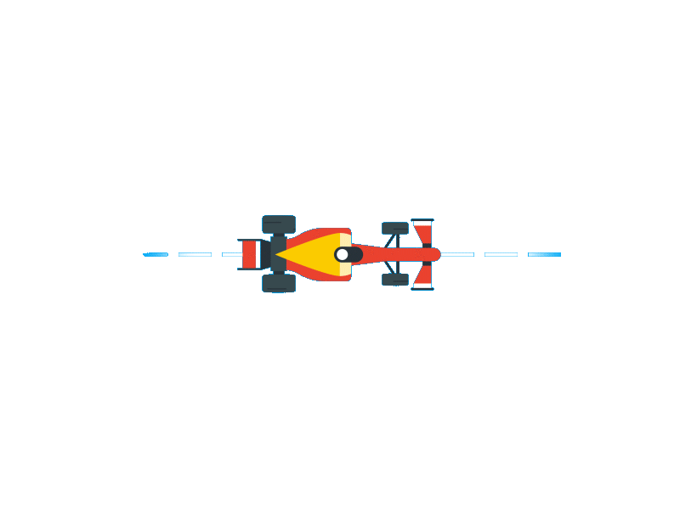
Electric
CSUN FSAE 2018 - 2019

Slide 2
Presentation Roadmap
High-level design
Embedded systems
Web software
Driver display

Slide 3
Software Architecture
Design + Looking Ahead

Slide 4
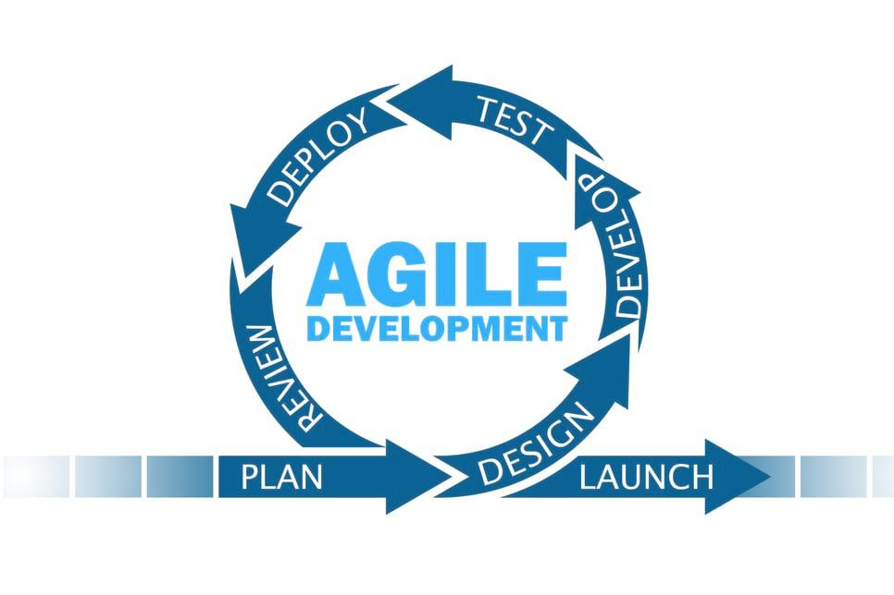
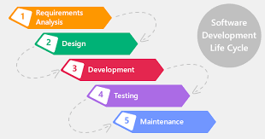
Design Methodologies
Design knowing requirements will change
90% of projects fail due to incomplete requirements or changing requirements
Waterfall produces rigid project structure ineffective at handling change
Agile prefers to deliver product for review rather than incorporate a large planning process which is likely to change on product delivery to customer

Slide 5






Internet of Things
The interconnection via the Internet of computing devices embedded in everyday objects, enabling them to send and receive data.
1.5 Mi

Slide 6
Protocol Networks
CAN - Single master, multiple slaves, assigns priority to sent data
I2C - Multiple master, multiple slaves, allows rapid throughput of sent data, highly configurable

Slide 7
Building a Software Suite

Slide 8
Design Considerations
System architecture
Code reuse
Modular design
Code extensibility
Code maintainability

Slide 9
Language Selection
Node.js
Modern, large community, powerful, integrated socket communication. Queues data if socket communication fails.
Python
Easy syntax, high readability, fast development, requires introducing new software for socket communication. Sends packet regardless of connection status.

Slide 10
System Improvements
Easy
Statistical analysis software suite
Car modifications
GPS
Driver camera
Medium
Optimum lap integration
Matlab + Simulink integration
Advanced
Machine learning
Active aerodynamics
Data mining

Slide 11
Embedded Systems
Data Acquisition + Data Transmission

Slide 12
Requirements
Accurately and precisely measure physical conditions in real time
Communicate with the on board ECU’s (Electronic control unit)
Transmit data in real time for analysis and visualization
Traction Control

Slide 13
Hardware
Development Board | Nvidia Jetson Tx2
Data Acquisition System | NI DAQ PCI-6220 + SH68-68-EP + BNC 2111
Can Bus Communication | Waveshare SN65HVD230
Wifi Communication | Avacom Long Distance Wifi
Sensors | BNC based 5/10 volt

Slide 14
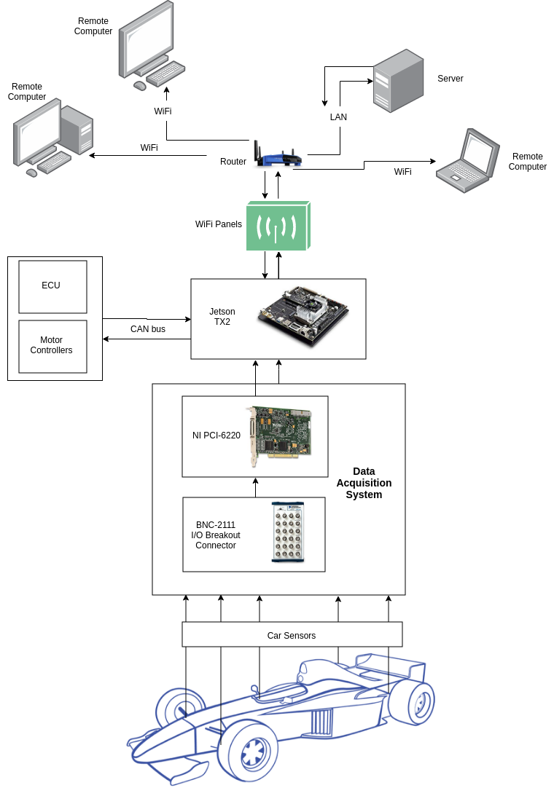

Slide 15
Frameworks/APIs
Interprocess Communication | ROS
Interfacing With DAQ System | Comedi
Interfacing with CAN BUS hardware | SocketCAN
Data Transmission | SocketIO
Local Data Storage | SQLite

Slide 16
Why ROS?
Support for multiple languages
Debugging tools
Standardized interprocess communication
Support for web based communication
Modularization
Maintainability

Slide 17
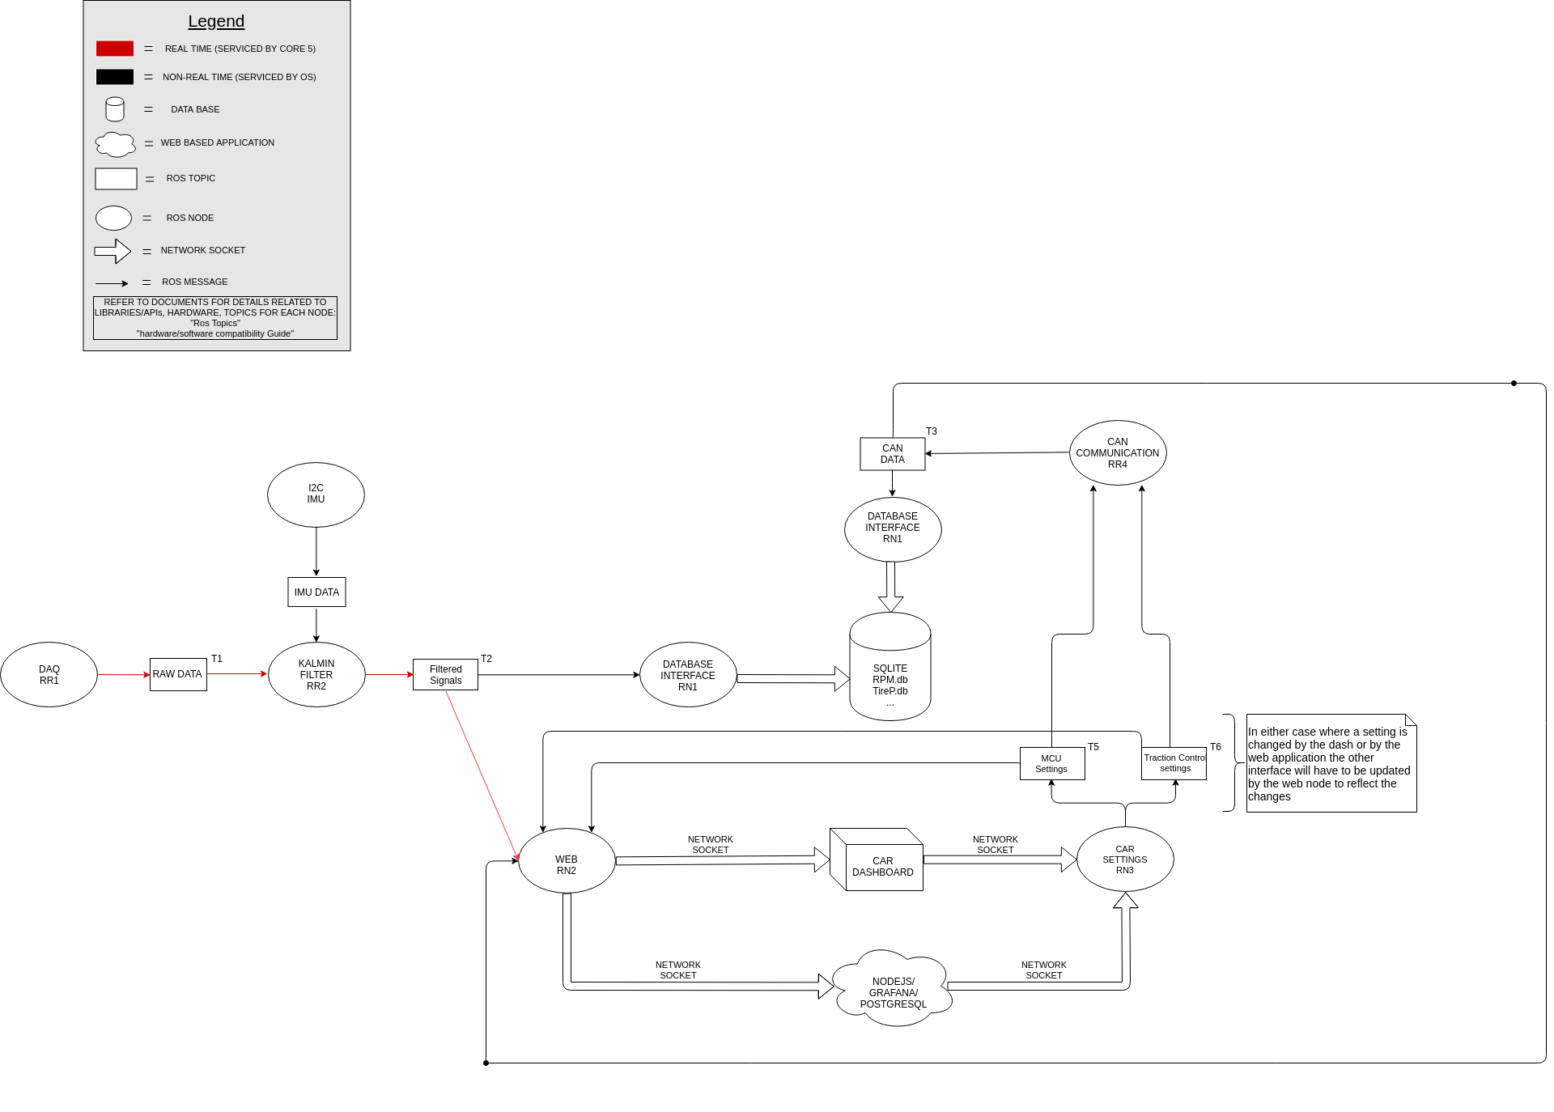

Slide 18
Traction Control
Programmed on the motor control unit (Unitek Bamocar)
PID controller implementation only needs calibration
Uses encoder data from motor
Programmed using Unitek Ndrive software
Can Bus communication as a means of interfacing with Unitek Motor Controller

Slide 19
Web Software
Connected Car

Slide 20
Wireless Communication
Our System delivers real time signals from all sensors on a local intranet.
A wireless connection is established between the car and local server to save data points in a time series database.
Appx. a 100 ms. delay is introduced by streaming data from all 17 data points, and displaying such data on all devices connected to the server. (No inherit limit)

Slide 21
Wireless Communication
Solving for Worst Case Scenario
Data loss due to wireless disconnect.
Using Socket.IO, a websocket based system, it ensures that in the case of network disconnect the device continues to ping the server until a handshake is complete
The vehicle has a black box system which records all data before it attempts to send the data wirelessly. Should the connection never recover the data can be exported manually and imported to the web system.

Slide 22
Data Collected
Data | Data source
Acceleration | Accelerometer
Motor temperature | Motor controller
Controls inputs | Potentiometer
Power | Motor controller
Suspension offset | Potentiometer
Aerodynamic load | Calculated - Suspension Offset
RPM | Motor controller
Speed | Motor controller
Accumulator temperature | BMS
Battery charge | BMS
Water temperature | Thermostat
Gravitation forces | Accelerometer + DOF
Traction | Hall effect
Steering input | Linear encoder

Slide 23
Data Storage
Databases of choice
PostgreSQL
Time series data points from all sensors organized by data types
Excel / CSV
Data made available via our web portal can easily be downloaded and opened in Excel.
This allows others to use such data for analysis and future Machine Learning

Slide 24
Application Hosting
Servers to be used
Local Intranet - Local Machine
Devices connected to the local server will see to the millisecond data.
Cloud Virtual Server - DigitalOcean
Data collected locally will be copied to a remote server within minutes.

Slide 25
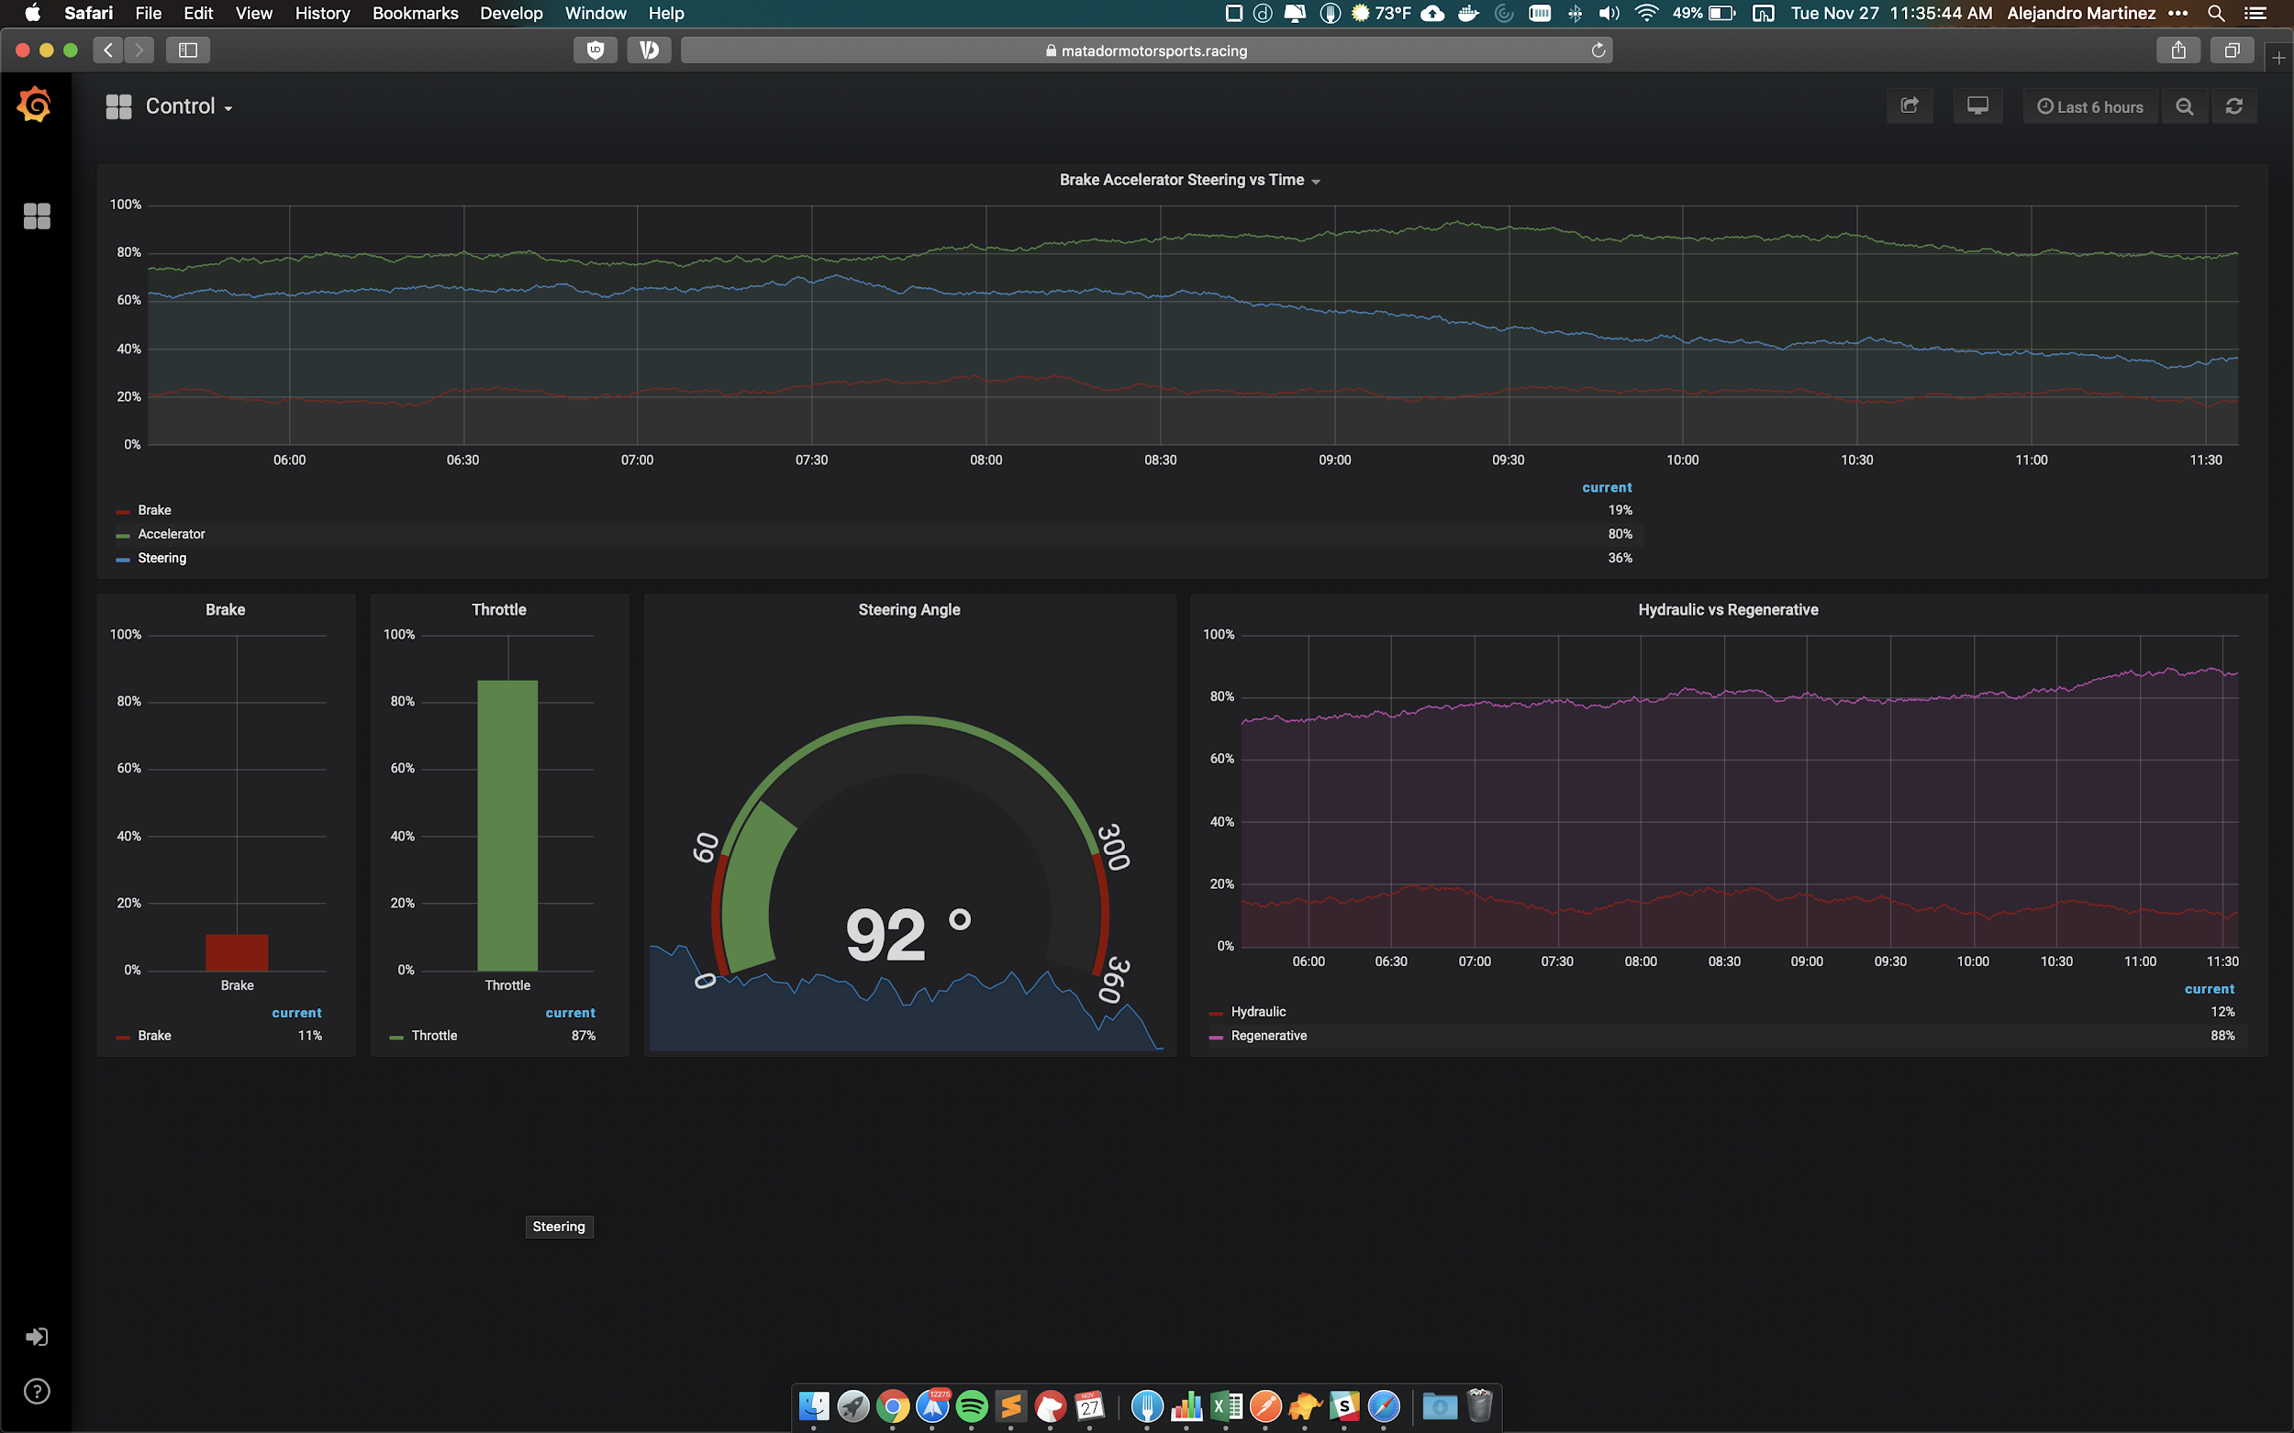
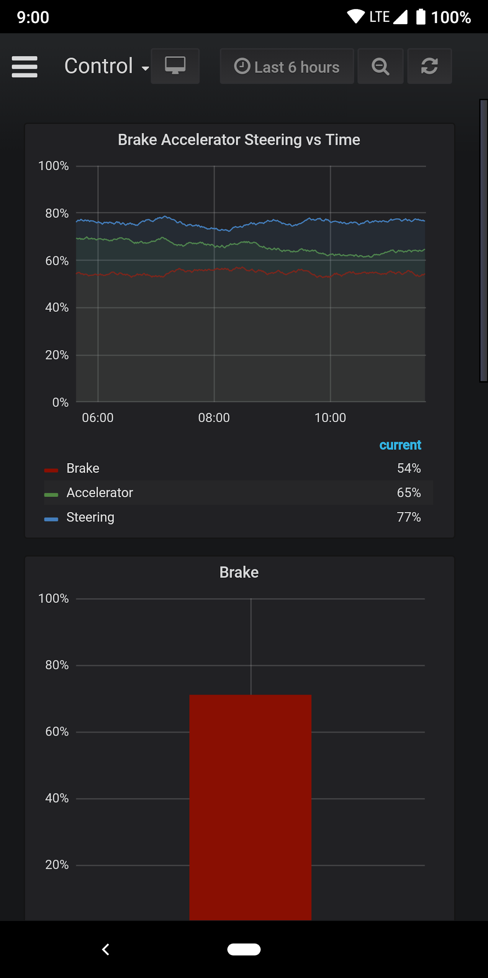
Place your screenshot here
MatadorMotorsports.racing
Current build is live to allow Mechanical Engineering students to play around with the interface and request changes
Allows our team to test our data intake pipelines.
Place your screenshot here

Slide 26
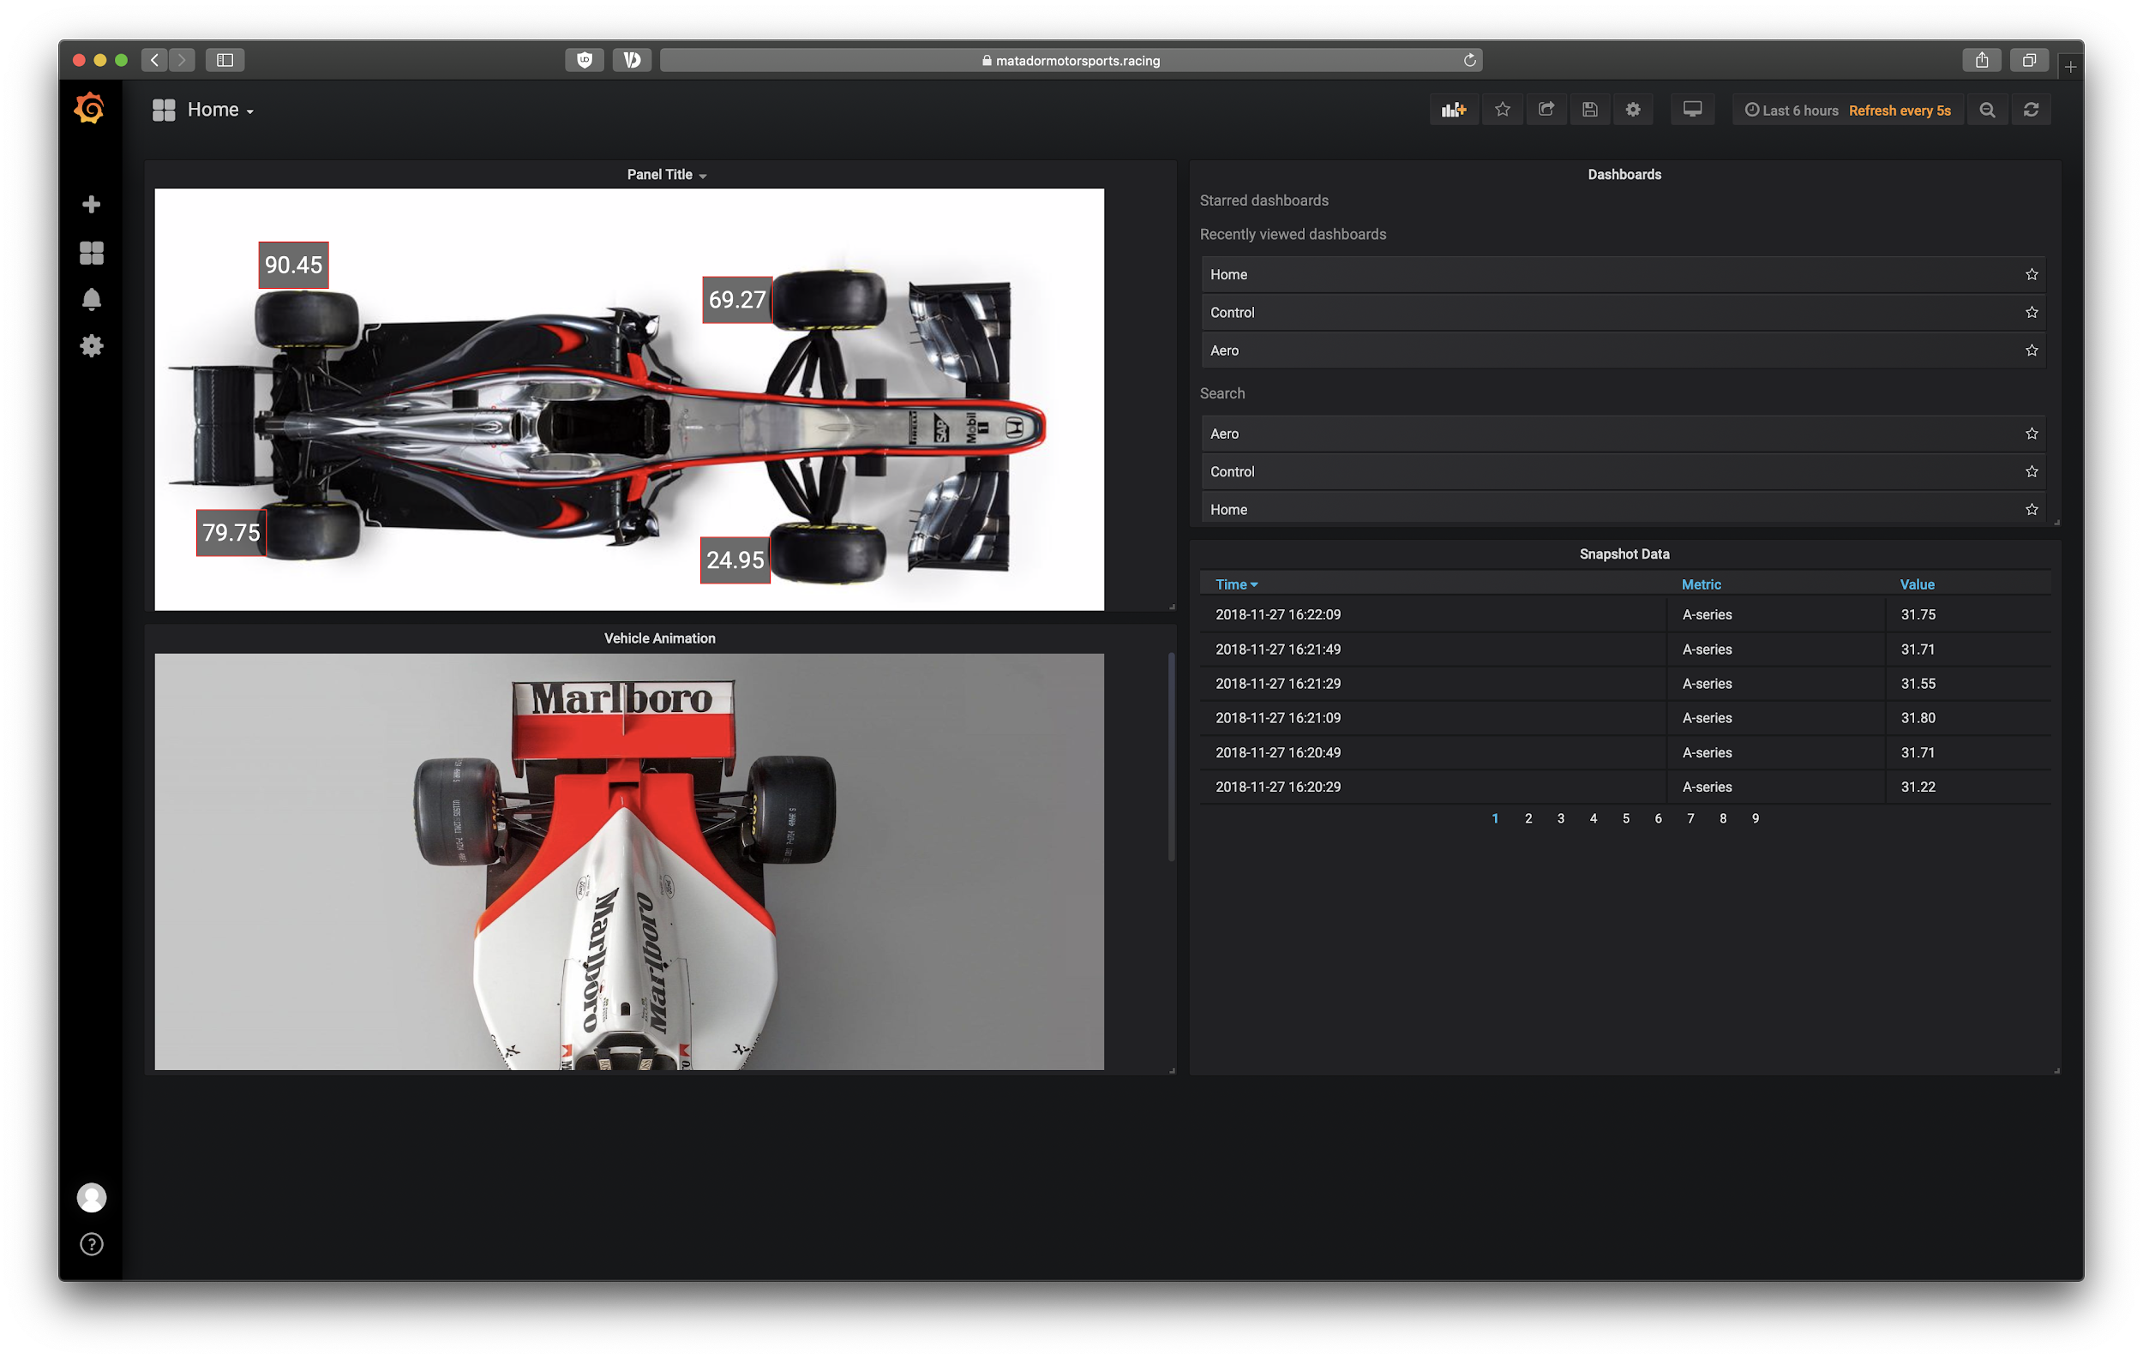

Slide 27
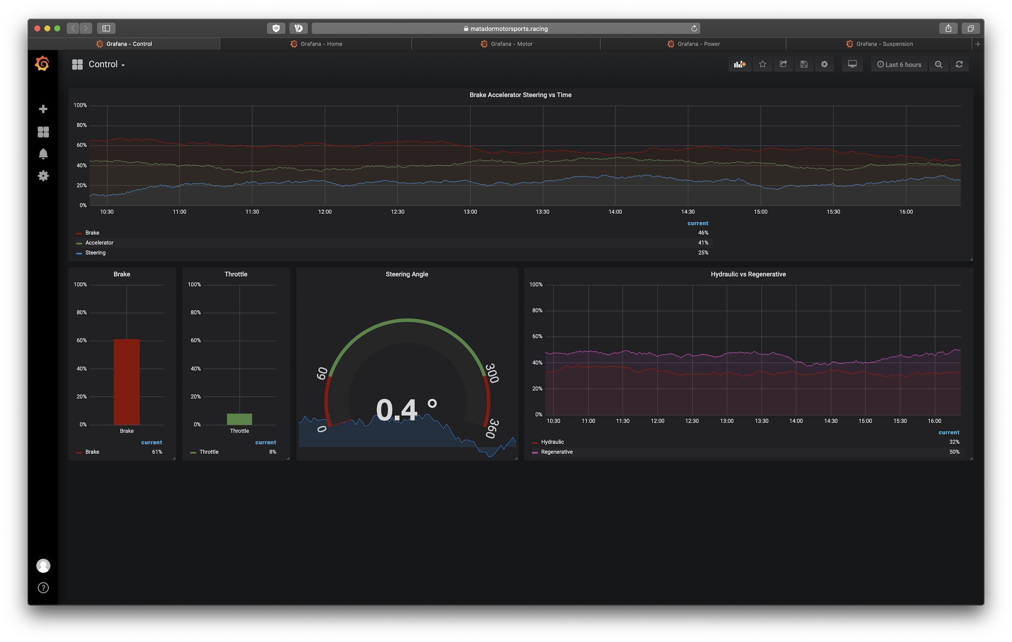

Slide 28
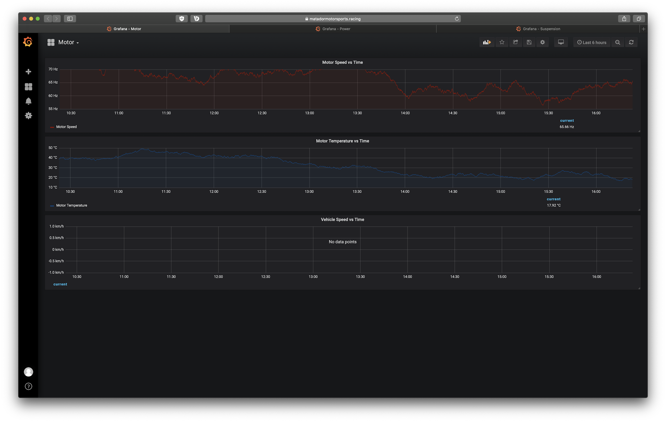

Slide 29
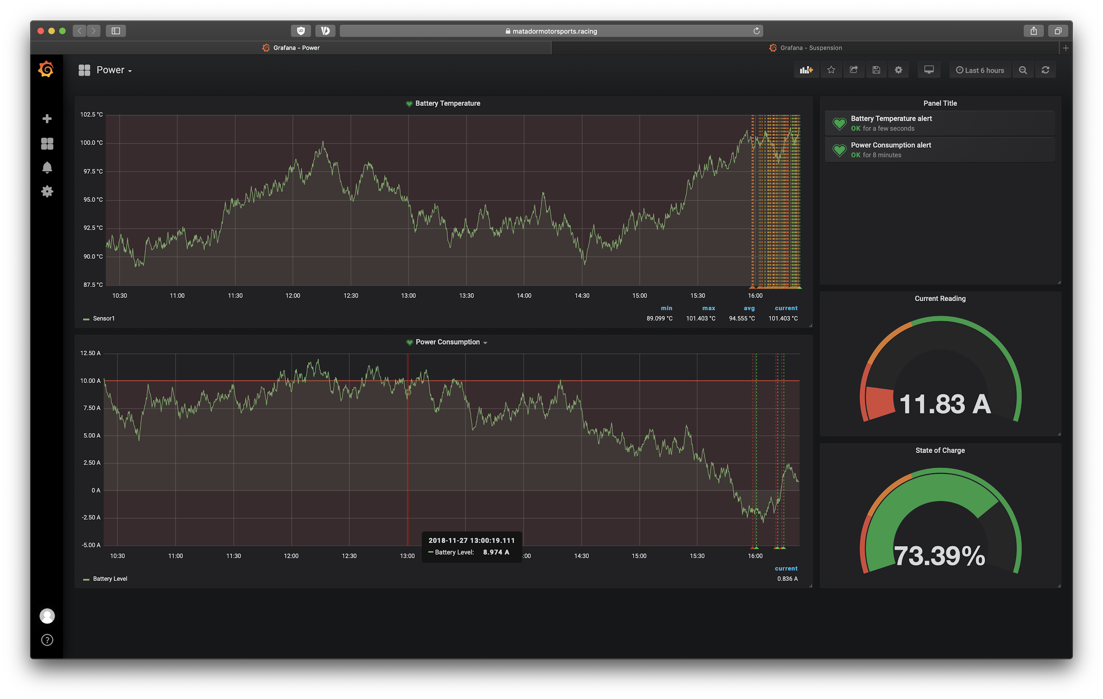

Slide 30
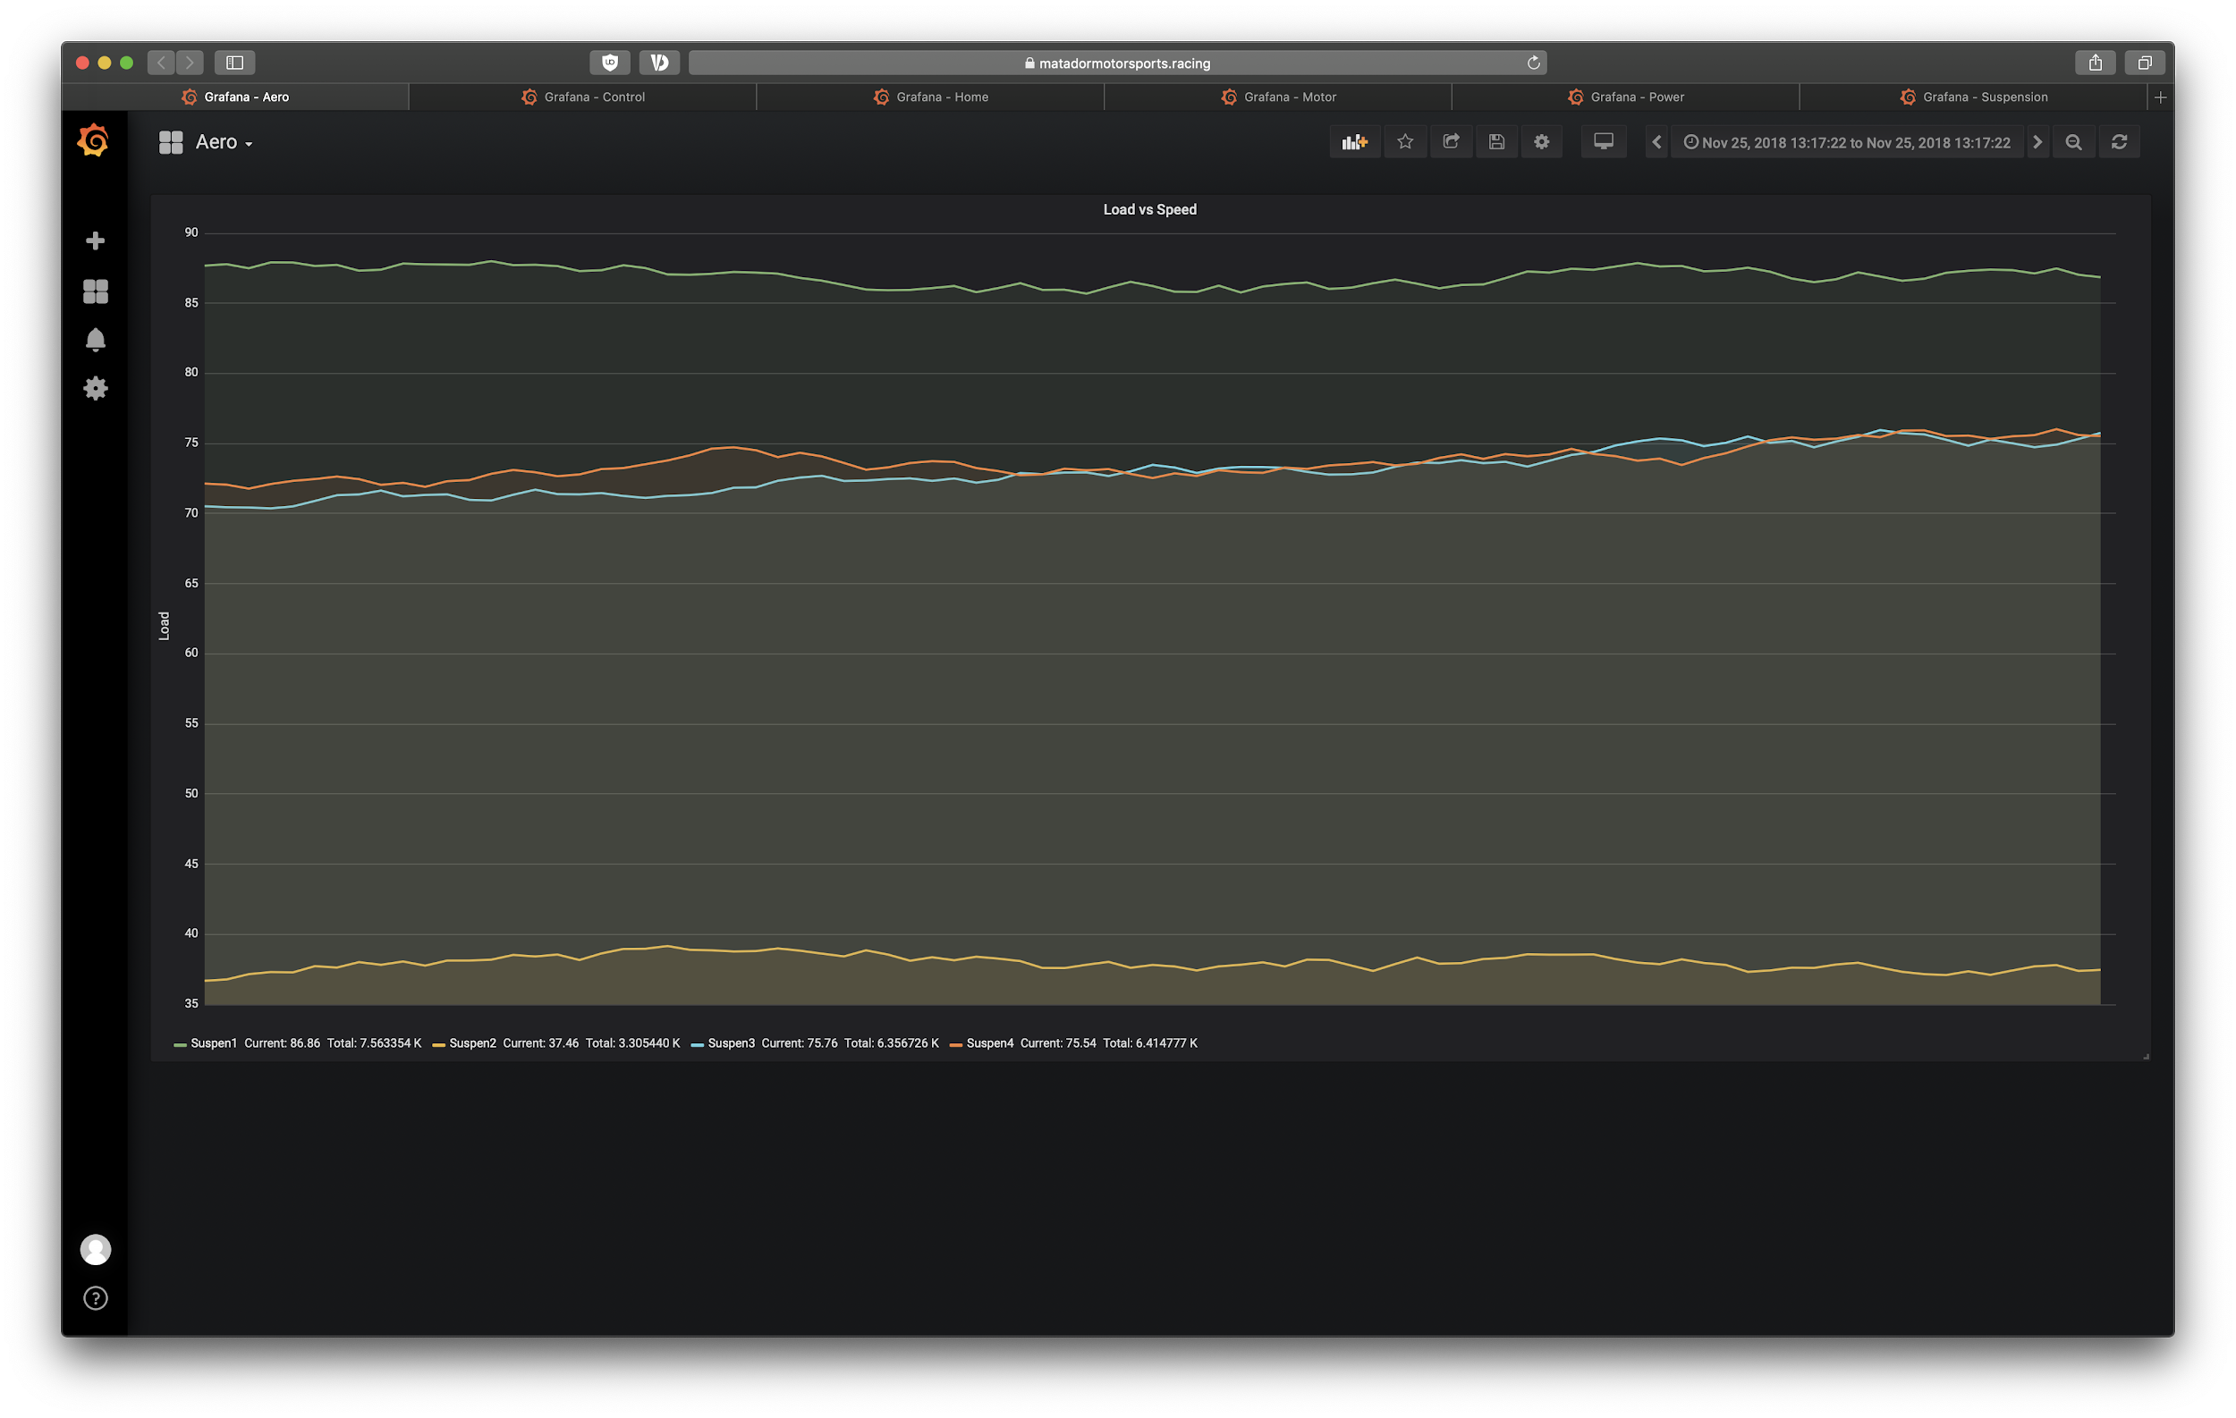

Slide 31
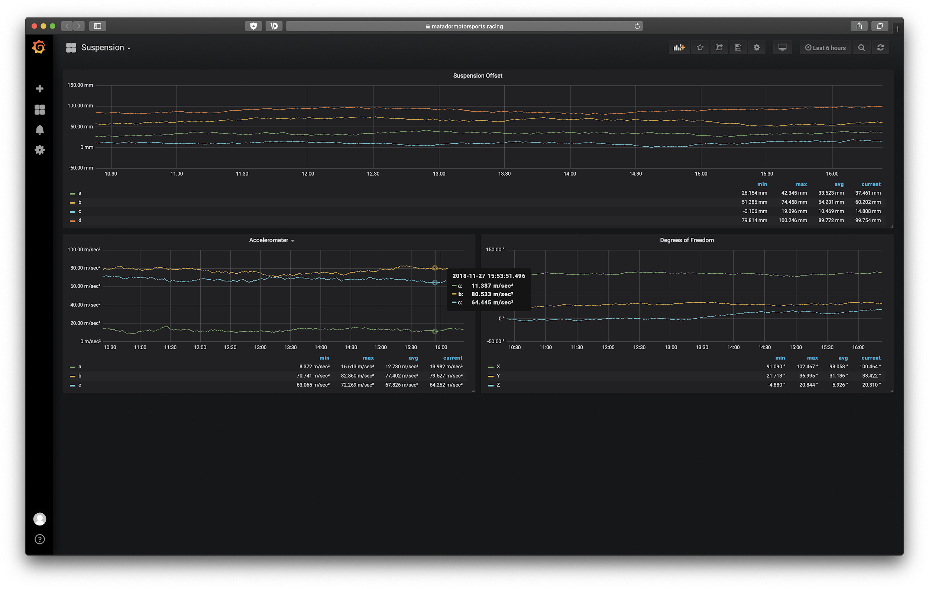

Slide 32
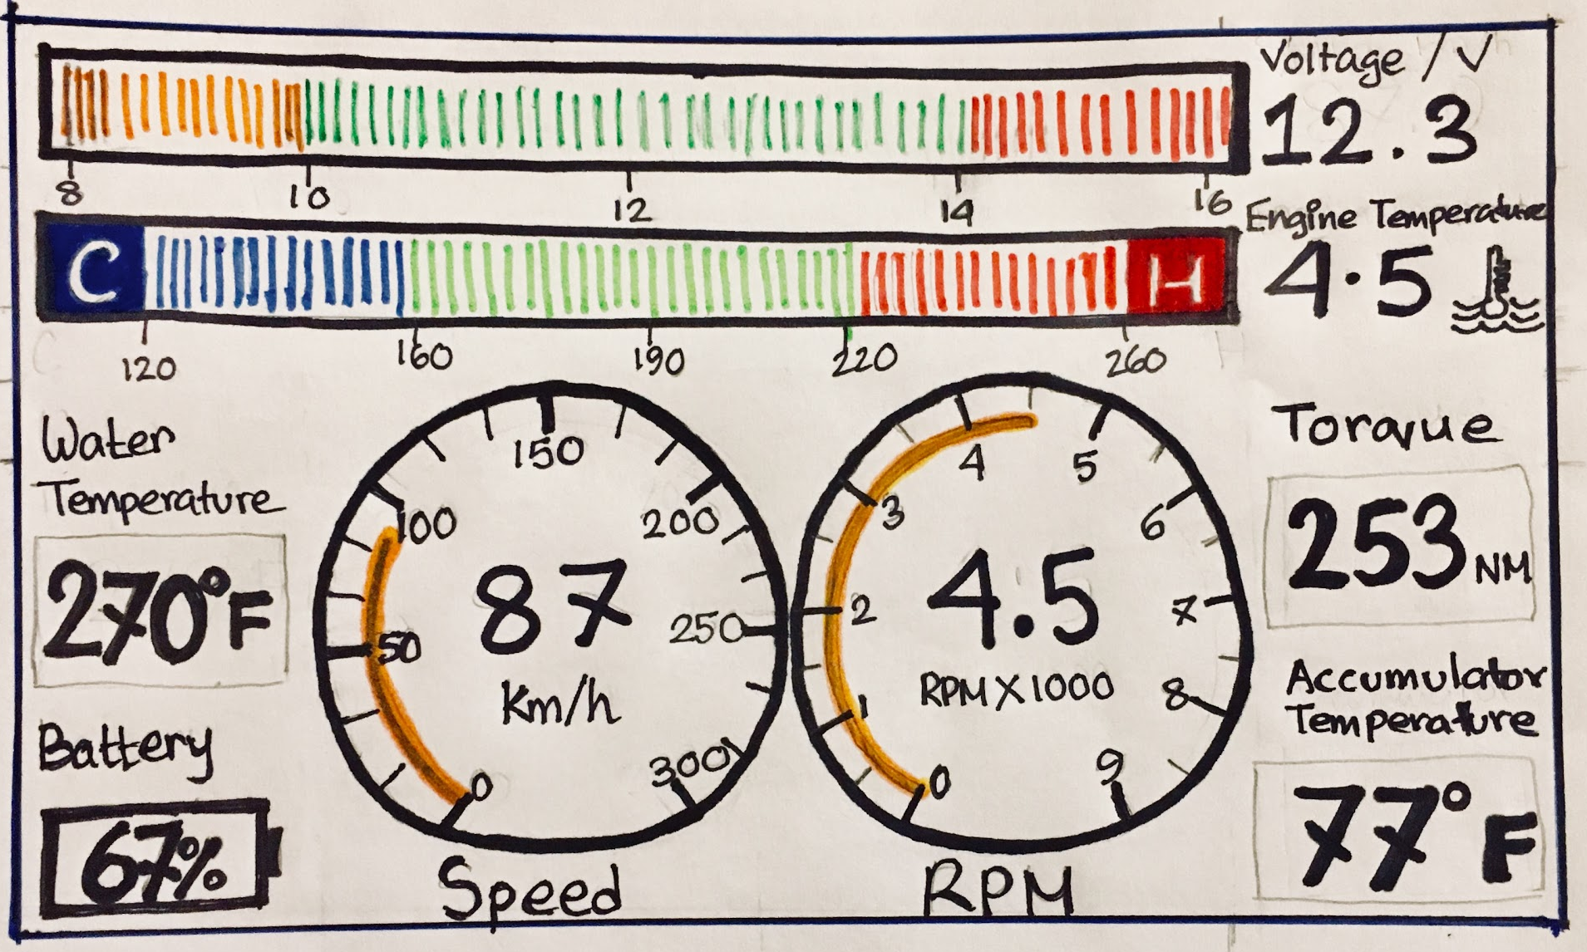
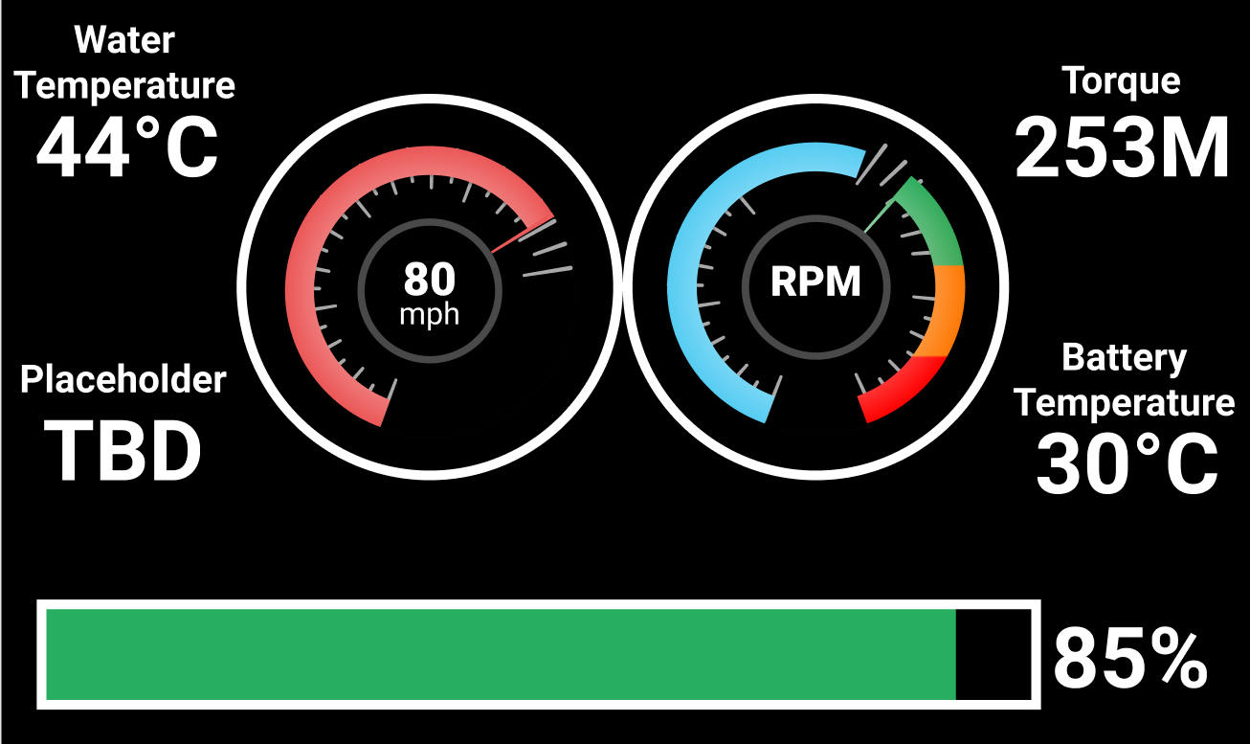
Driver’s Display

Slide 33
Real Time Alerting
Grafana Alerts
Pitcrew
Engineers watching from the pit want to be aware of any issues that are occuring while the car is in motion that require immediate attention.
Driver
Using high / low limits for data points the web team wants to deliver notifications to the driver with suggestions to adjust driving style or warning of issues detected.

Slide 34
Work In Progress
Pages still being worked on:
Wireless communication monitoring
Server (Remote + Local) monitoring
GPS Data + Lap Times
Vehicle Modification Screen
DB replication for Remote Viewing

Slide 35
Simulation
OptimumLap
Vehicle Dynamics Simulation data is being sent to our data intake pipeline to simulate data coming from onboard sensors.
Postman Collections + Runner
API interface tool simulates POST commands to our API service using true to data delays.

Slide 36
THANKS!

